Slide 1
Capstone Project
Car Details Price Prediction
(Machine Learning ) (Regression) Individual Ratnesh Verma
Github link-https://github.com/Ratnesh1210/Car-details-price-prediction

Slide 2
Github link
https://github.com/Ratnesh1210/Car-details-price-prediction

Slide 3
Points for Discussions
Data Summary
Data wrangling and Visualisation
Feature Engineering and Data Pre-processing
ML model Implementation
1. Linear Regression
2. Decision Tree Regressor
3. Random Forest Regressor
4. Lasso and Ridge Regression (L1 and L2 Regularization)
Conclusion

Slide 4
Data Summary
The given dataset is a dataset of Car Details. There are 4340 rows and 8 columns in the data set. The file format is the form of csv.
Data Summary
Categorical Data
Name
Year
Fuel
Seller Type
Transmission
Owner
Numerical Data
Selling price (Target variable)
Km driven

Slide 5
Data Summary
There are no null values present in the dataset.
The number of duplicate row present in the dataset is 763.
There are 1491 unique cars are registered in the data set.
The car details are available from year 1992 to 2019
The Fuel Type of car classified into 4 types:
1. Petrol 2. CNG
3. Diesel 4. Electric
There are three types of seller:
1. Individual 2. Trustmark dealer
3. Dealer
The types of transmission are:
1. Manual 2. Automatic
Types of owner are:
1. First Owner 2. Second owner
3. Third owner 4. Fourth and Above owner
5. Test and Drive car

Slide 6
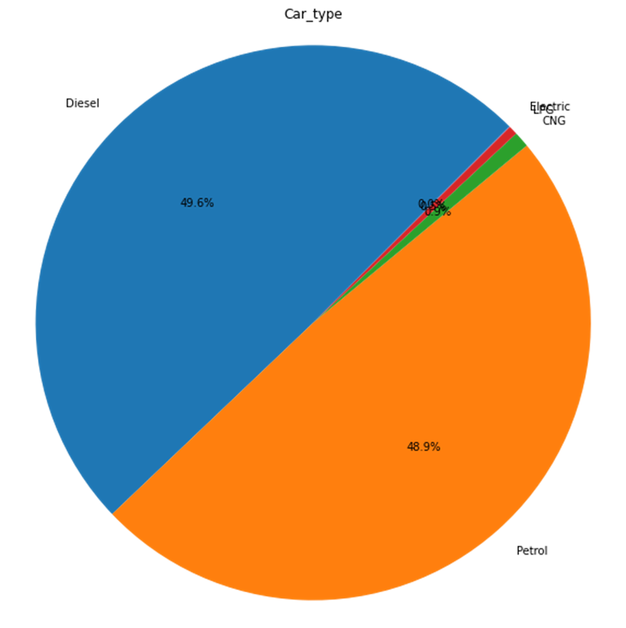
Data Wrangling and Visualisation 1. Count of each type of car.
The maximum number of cars are of Diesel and Petrol.
The minimum number of cars are of Electric and CNG

Slide 7
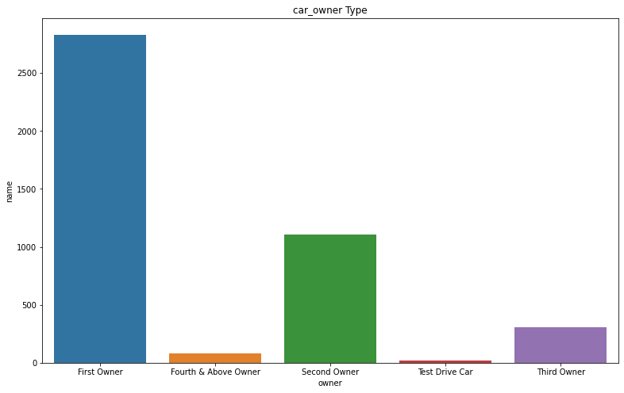
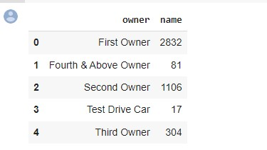
2. Number of Types of Owners
Here we can see that the number of first owner is maximum and test Drive car are minimum.

Slide 8
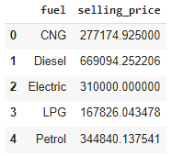
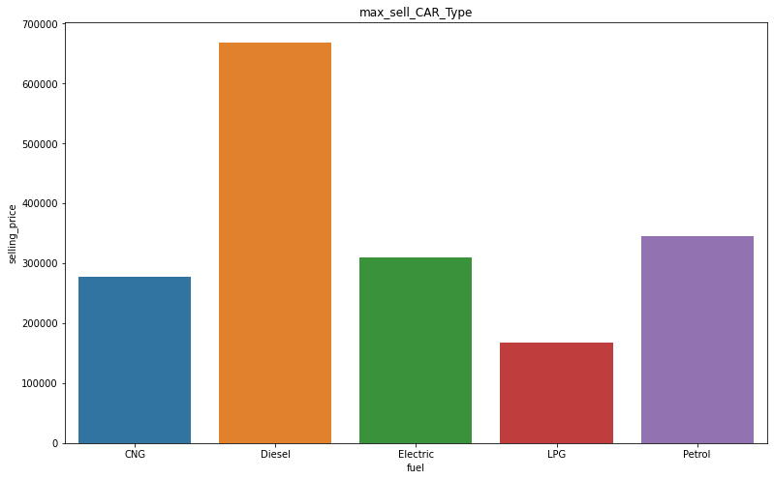
3- Types of cars and its Average selling price
Here we can see that Diesel cars most costlier and LPG car type are less costlier.

Slide 9
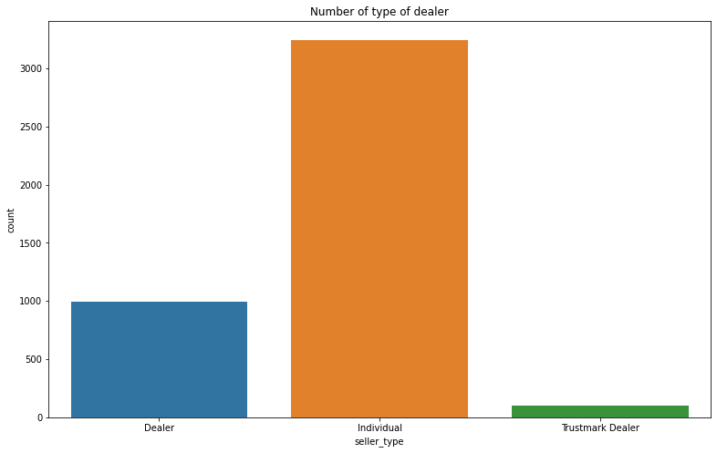
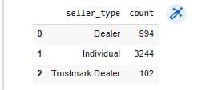
4. Types of seller and their count
Here we can see that Individual dealers are maximum and Trustmark Dealer are minimum.

Slide 10
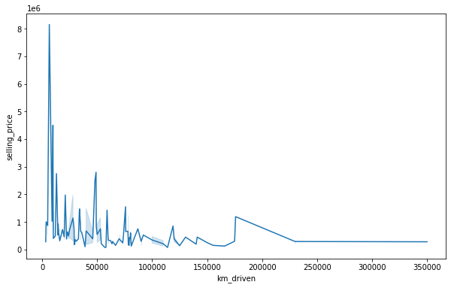
5. Plot of price vs KM driven
As we can see that as the kilometer driven is increasing the selling price of car is decreasing.
After 250000 Km the selling price of car become constant.

Slide 11
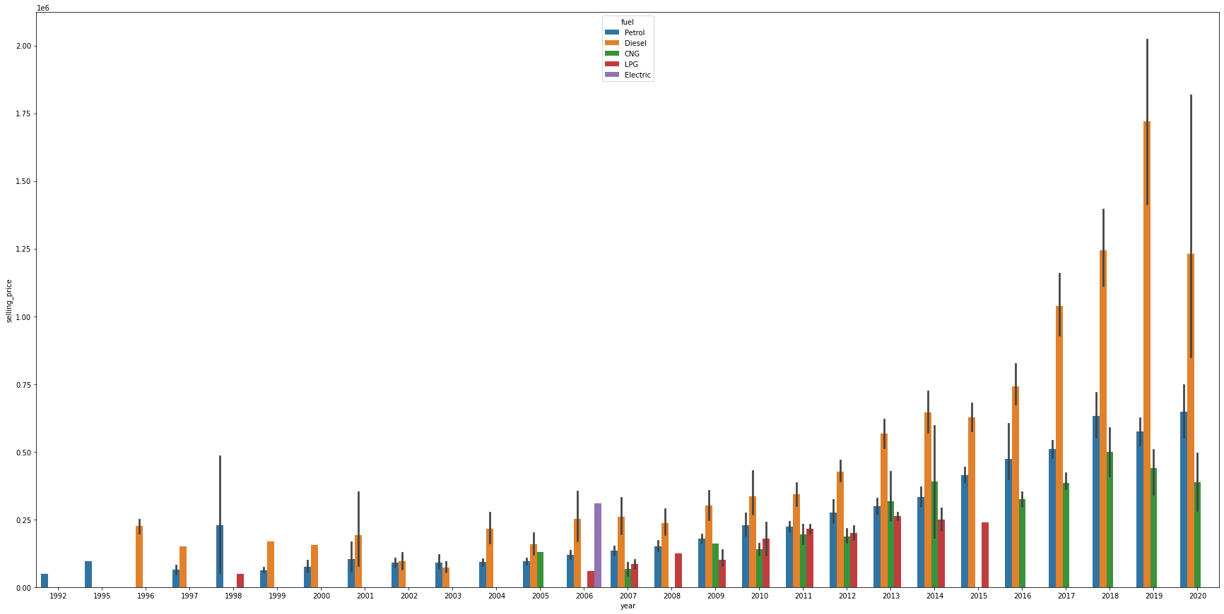
6. Plot of Average selling price in each year base on fuel type

Slide 12
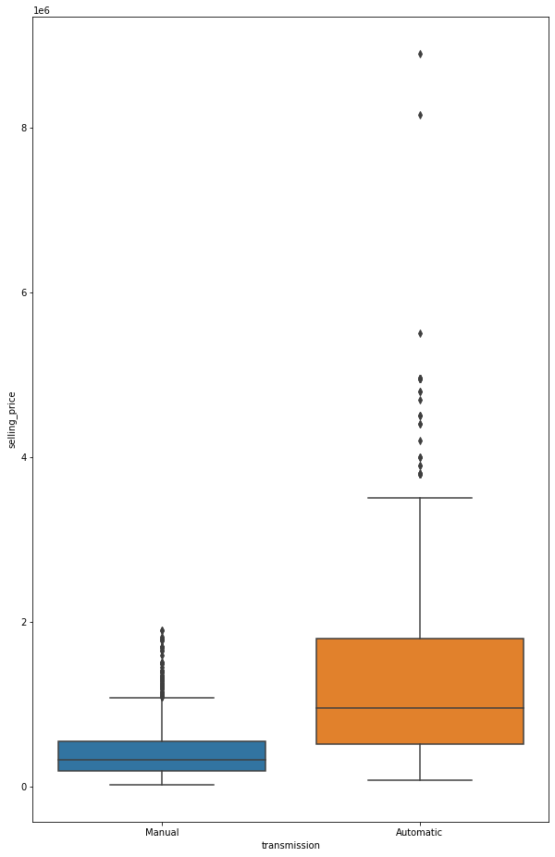
6.Box plot of selling price on the basis of transmission of car
As we can see that the minimum, maximum and median selling price of manual transmission cars are low as compare to automatic.
There are maximum number of outliers are present in the selling price of automatic cars.

Slide 13
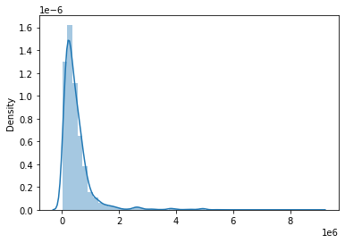
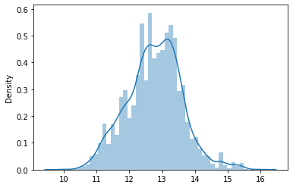
1. Distribution plot of Price
Feature Engineering and Data Pre-processing
original price data
After logarithmic transformation
Here after applying logarithmic transformation the data become normally distributed.

Slide 14
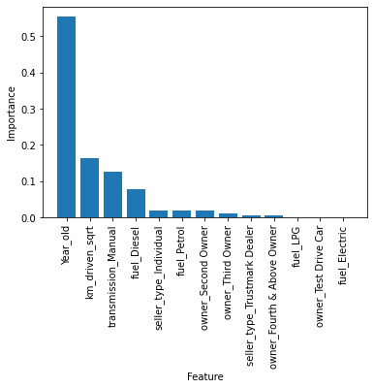
2. Features importance of variables
It tells how powerful is that feature in predicting the target variable.
Here we can see that the feature “fuel_LPG”,” owner_Test Drive Car” and “fuel_Electric” have very less importance so we can ignore this feature in training the ML model.

Slide 15
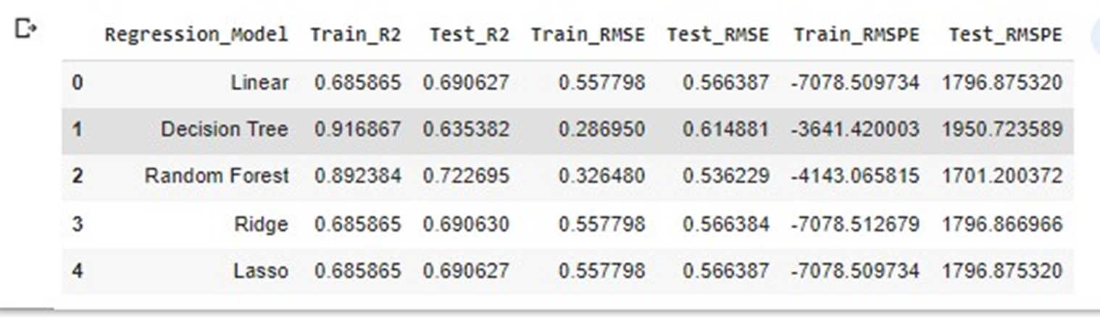
ML MODEL
Linear Regression
Decision Tree Regressor
Random Forest Regressor
Lasso and Ridge Regression (L1 and L2 Regularization)
Metrics Table
Among all the Random Forest Regressor is performing the best with the accuracy of 72.26% followed by Linear and Lasso Regressor with accuracy of 69.06 % so here we are choosing Random Forest Regressor for best prediction.

Slide 16
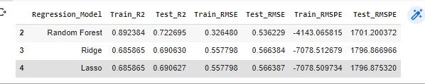
Prediction of random 20 data points
For this 20 data point R2 score is 89.92 %

Slide 17
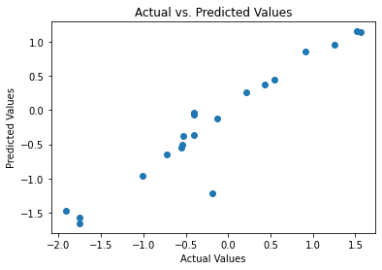
Plot between Actual and Predicted Data of randomly 20 data points.
As we can see that Actual and predicted values almost follow linear path so our model is almost best fit..

Slide 18
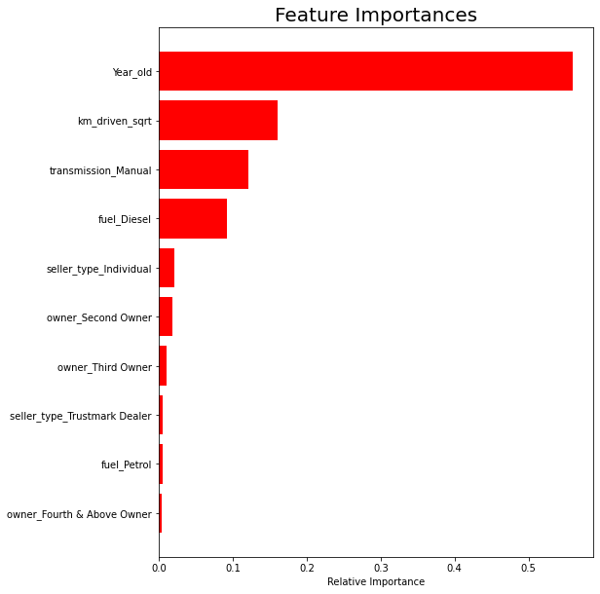
Features important based on Random Forest Regressor

Slide 19
Conclusion
Before creating the regression model, it is crucial to clean and pre-process the data so that it is in the right format.
Unnecessary data that skew the results were also filtered out.
Feature engineering and exploratory data analysis were performed to gather more meaningful information from the data.
Apart from this, various data visualization, like box plot, frequency plot, histogram, pair plot, correlation matrix and scatter plot were created to understand the uni-variate distribution and multi-variate relationship of the data
Majority of cars are Diesel (49.6%) and Petrol (48.9%)
The number of unique car count is: 1491
Maximum sold cars belongs to First owners.
Selling price of cars is decreasing as per their running status.
We performed Regression Analysis on our data set to model the prices of cars.
Among the all regression models, it is clear that Random Forest Regressor is giving the best result with the accuracy of 72.4% followed by linear Regressor with accuracy of 69.2%. So, we will use the random forest regressor to predict the sales.

Slide 20
Thank You

